Slide 1
Business of Platforms: Platforms (version 11142022)
A platform is a collection of essential components that brings together a variety of components or complementary goods and allows them to function together
Platform’s output could be sold to the same customers, e.g., iPhone and iPhone apps
Or a platform could bring together two different groups, e.g., drivers and riders in Uber

Slide 2
Examples
Intel microchip allows a keyboard, an OS, a video monitor, and other components to connect and function
Windows platform allows a variety of applications to function
In computing systems, a platform opens hooks (Application Programming Interfaces, APIs) to which components or applications attach

Slide 3

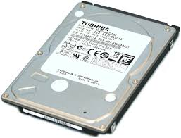
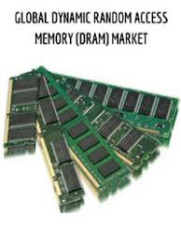
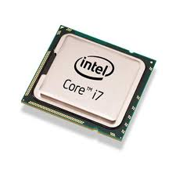


Intel chip is a multi-sided platform for PC peripherals (complementary components)

Slide 4

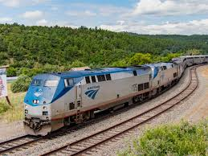
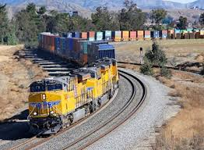
Railroad infrastructure platform (tracks) with passenger and freight trains
Notes:
Notice the railroad cars can only ride on a particular gauge of rails. This is an issue of compatibility that we will discuss later in the course.

Slide 5



Public roads as multi-sided platforms for cars and trucks

Slide 6
Facebook is a multi-sided platform bringing together various parties
Users
Facebook
Applications
Partners
Advertisers

Slide 7
1. What are multi-sided platforms
A platform
defines the intermediary that connects and coordinates buyers and sellers (or, in general, complementary sets of actors or functions)
typically exploits network effects and feedback loops (to discuss later)
Notes:
Also, a platform may reduce search or transaction costs.

Slide 8
A platform
May facilitate transactions (transactional platform)
Amex facilitates transactions between merchants and buyers
May facilitate innovation (innovation platform)
CRISPR (a setup allowing gene editing)
Could be both transactional and innovative
Windows facilitates transactions as well as new innovative apps

Slide 9
Innovation platform: Gene editing using the CRISPR technology
Treated cases of sickle cell anemia
Edited T-cells to fight lymphoma and other cancers
Edited photoreceptor cells to treat inherited blindness
Edited bacteria to eat carbon dioxide!
Still in early years, but both the Pfizer and Moderna covid-19 vaccines were created using CRISPR
Notes:
https://www.healthline.com/health-news/first-person-treated-for-sickle-cell-disease-with-crispr-is-doing-well
https://www.sciencemag.org/news/2020/02/cutting-edge-crispr-gene-editing-appears-safe-three-cancer-patients
https://onezero.medium.com/how-a-shot-of-crispr-could-restore-sight-to-the-blind-2be74bab44e8
https://www.nature.com/articles/d41586-019-03679-x

Slide 10
2. Who gets charged by the platform; who is subsidized
Some platforms collect from both sides, some from one side only and the other side pays nothing, and some collect from one side and subsidize the other
Prices are determined by the two markets’ characteristics
Generally, prices are higher on the less elastic side
Does the platform charge per unit or through a subscription fee?
Notes:
The availability of prices on both sides of a platform or network allows for complex pricing strategies, and, depending on the dynamics and market shares on the two sides of the market, can be used strategically to enhance and leverage a firm’s strong strategic position on one side of the network

Slide 11


A two-sided platform
can make money from either or both sides of the platform
expensive, can create pdf docs
free, can read pdf docs

Slide 12



Platform Google charges advertisers, provides free search
Free search
Green arrow: payments to the platform

Slide 13



Telephone platform: originator pays; “Collect or 800 calls”: receiver pays.
free
10c

Slide 14

Uber collects from riders and pays drivers: R > s > 0
s
R
Driver
Rider
Transport
Green arrows: payments or subsidies of the platform

Slide 15

Amex collects from merchants and subsidizes cardholders
Merchant
Pays 3%
per $ of sales
Cardholder
Receives 1% “rewards”
per $ of purchases
Payment facilitation
0.5% cost
1.5% profit
per $ of transcation
Green arrows: payments or subsidies of the platform

Slide 16


Windows platform charges user, subsidizes apps; users pay apps too
Green arrows: payments/subsidies of the platform
Black arrows: user payments to apps
Notes:
Platform Windows subsidizes all apps on Windows. Apps made by Microsoft are subsidized directly. Other apps, like Adobe Acrobat are subsidized in kind, by including in Windows subroutines that are useful to Adobe and, if not available in Windows, Adobe would have to create itself.

Slide 17
Windows platform charges user, subsidizes apps; users pay apps too
s1
s2
p
p2
p1
Green arrows: payments/subsidies of the platform
Black arrows: user payments to apps
Notes:
Arrows show directing of payment. Payment may be in kind. For example, Windows contain subroutines that reduce the cost of apps.

Slide 18


Platform Xbox charges user and royalty to the game app

Slide 19
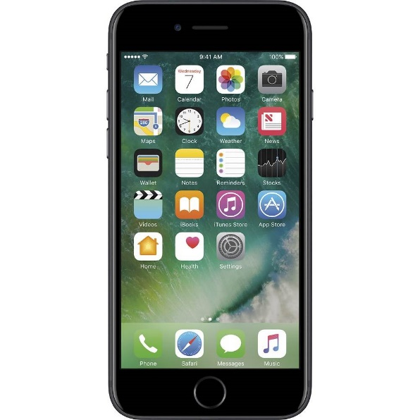


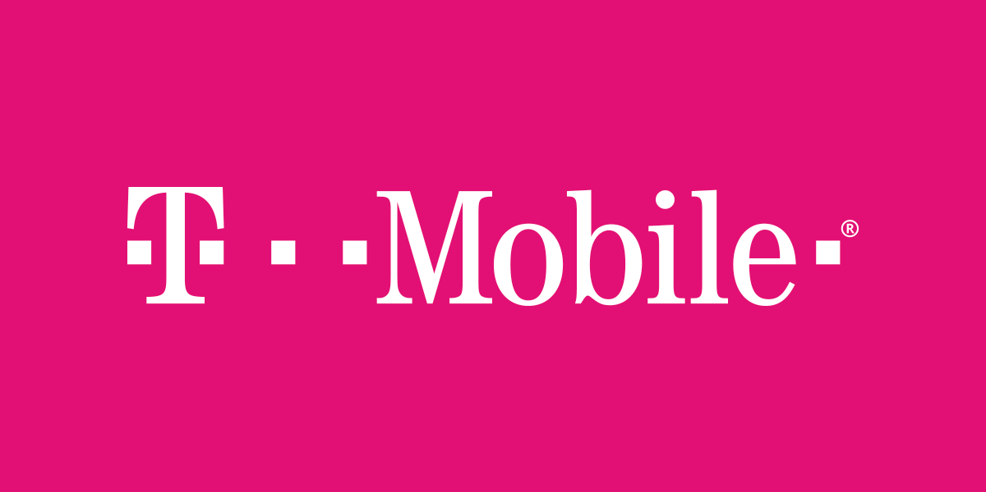
Cell phones: both sides pay their telecom company/carrier

Slide 20
Internet backbones charge both senders and receivers (through subscription)
ISP
ISP
Netflix
Google
Internet Backbone
Business Customers
ISP
ISP
(Residential
Access Network)
Residential Customers
R: subscription price
Notes:
An Internet backbone leases on a monthly basis a virtual pipeline of a certain bandwidth to Internet Service Providers (ISPs), with the obligation to deliver the whole Internet to an ISP customer.

Slide 21
Examples of platforms
Platform Side 1 Side 2 Service(s)
Uber Driver Rider Transport
Airbnb Apartment User Accommodation
MSFT OS MS-Word User Writing
Apple iOS Phone apps User Various
Google Advertiser User Ads/Search
M-Pesa Money sender Money receiver Money transfer
Sony PS3 Game User Game playing
Internet Google Search User Search
Internet Netflix Video user Video
Internet Kindle books Kindle app eBook
YouTube Video creators Video users Video
Facebook User User Discussion, live audio, video

Slide 22
3. Features of a platform vs apps or other components (peripherals)
Essential: Platform is essential/indispensable for services produced using complementary components
No value in isolation: Typically, a platform has little or no value without the complements
Less variability: Platform has less variability than complements or peripherals
Thin connection: Each component or app (module) performs many internal functions and is connected “thinly” with the platform but “thickly” within itself
Modular setup of platform and peripherals: platform and peripherals are easily distinguishable

Slide 23
4. History: Silos vs complementary interoperable modules
Before the late 1970s, computing services were provided by vertically integrated companies, so-called “silos,” selling hardware & software, e.g. IBM
In late 1970s, Microsoft was the first successful company to sell software without hardware
This transformed the silos to collections of complementary modules
Each module typically produced by a different company

Slide 24
Silos v. complementary interoperable modules Pre-1980 Post-1980
IBM mainframe
Various companies’ software
Microsoft software
Hardware: Intel microchip, various OEMs of PCs
Apps
Apps
IBM Apps
IBM OS
OS: DOS,
Windows
IBM Microchip
Intel, AMD
Microchip

Slide 25
Silos v. complementary modules
Pricing: Silos set up a single price for the package of hardware and software
Typically, price was for the hardware and software was bundled for free
Limitations of silos:
You could only use the software of the hardware seller
Hardware difficult to scale down
Major advantage of silos: Hardware was top of the line

Slide 26
Advantages of modularity
In principle, could combine the best of each: hardware, OS, apps (“mix and match”)
Large variety of software produced by third parties
Faster technological change in both software and hardware
Notes:
API = Application product interface

Slide 27
Modules’ interconnection requires technical standards
defining the connections between hardware and OS (set by Intel) and between OS and apps (set by Microsoft)
Platforms such as Microsoft and Intel defined these technical standards, called “application product interfaces,” APIs
Platforms created barriers to entry to rival platforms through these APIs

Slide 28
The birth of Microsoft, the first software-only computer company
https://www.youtube.com/watch?v=cSOx0Hv8s3g
Microsoft’s slogan in 1980s:
“a computer on every desk and in every home”
We are now at
“a computer in every pocket"

Slide 29


Slide 30
5. Who makes most of the money in the ecosystem?
Typically, the platform makes much more money than the apps or peripherals
Constant complaint against platforms Microsoft, Google, Intel by apps
Will go in details later in the course

Slide 31
6. Power of platforms: Best platform wins over best product
Apple’s Mac was considered a better product than DOS or early Windows PCs
But Windows had wide adoption and a huge number of apps in comparison
Result: the Windows platform has 95% market share vs Mac’s 3% over the last 40 years

Slide 32
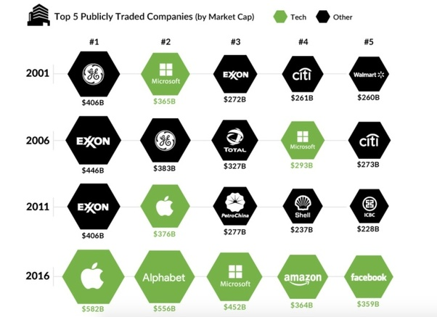
Platforms are taking over …
Notes:
Thanks to Marshall Van Alstyne for this slide.

Slide 33
7. Why are platforms so profitable?
Two reasons:
Network effects
Platforms have only small fixed and variable investments

Slide 34
8. Why are platforms taking over? Reason 1: network effects
Network effect: a user will pay more to connect to a larger network
Larger scale increases profits exponentially
Notes:
Thanks to Thanks to Marshall Van Alstyne for the illustration.

Slide 35
Special features of markets with network effects
Increasing returns to scale in consumption (network effects)
A market exhibits network effects when the value of a transaction (or subscription) is higher when more units change hands, everything else being equal
Two types of network effects:
Direct (same side)
Indirect (cross-side)

Slide 36
8.1 Same-side (direct) network effects: a customer benefits from other customers connecting on the same side of the platform
Platform
(Telephone, fax, Instant
Messenger, Facebook)
Customer 1
Customer 2
Customer 3
Notes:
Same-side (direct) network effects mean that a customer subscribing to a network influences positively (increases) the benefit of other customers on the same side of the network. For example, customers of the same instant messenger benefit each other. The more customers on the particular instant messenger app, the more valuable is the app to a subscriber.

Slide 37
Special features of markets with network effects: complementarities
In a traditional network, network effects arise because a typical subscriber can reach more subscribers in a larger network
Adding subscriber G makes phone calls AG, BG,… possible

Slide 38
Special features of markets with network effects: complementarities
Network effects arise because of complementarities
When customer A makes a phone call to customer B, he uses both AS and BS
Although goods “access to the switch” AS, BS, …, GS have the same industrial classification and traditional economics would classify them as substitutes, they are used as complements
38
Notes:
38

Slide 39
8.2 Cross-side (indirect) network effects: a customer benefits from more participation on the other side of the platform
Drivers
Riders
Notes:
In many platforms, a participant in one side of the platform benefits from more participants in the other side of the platform. These are called cross-side (indirect) network effects. For example, in Uber, availability of more drivers and cars reduces the delay in pickups, and increases the value of the Uber subscription of a user. Similarly, a higher number of subscribers means more potential pickups and therefore increases the value of driving, attracting more drivers.

Slide 40
The more Uber cabs in a city, the more riders they will attract and vice versa
Uber reaps network effects by increasing scale
Notes:
D1, … Dm are customers. S1, … Sn are drivers. As the scale increases, both drivers and customers benefit. Also, as scale increases, the profits of Uber increases approximately linearly with scale (approximately 20% of every fare) since most Uber costs are fixed and do not vary with scale.

Slide 41
Two-sided platform as a virtual network: components Di complementary with components Sj; has network effects
In a virtual network, network effects arise because larger sales of components of type D induce larger availability of complementary components S₁, ..., S_{n}, thereby increasing the value of components of type D
Examples:
CPUs & monitors
Users and advertisers in Yellow Pages or Internet search engines
Uber
Cameras and film

Slide 42
9. What happens when there are two or more competing platforms? Examples
Android phones vs iPhones
MS-DOS v. DR-DOS (OSs for PCs)
Windows v. IBM’s OS/2 (OSs GUIs for PCs)
Intel v. AMD microchips for PCs
Uber v. Lyft
Google search v. Bing search
VHS v. Betamax video recorder
In most cases, competition results in a clear winner: MS-DOS, Windows, Intel, Uber, Google search, VHS
Why?

Slide 43
10. “Winner-takes-most”
With network effects, larger sales size is the equivalent to higher quality
Consumers prefer products with higher sales because they have many complements
Prefer Windows because of many apps, even when stand-alone Mac is more desirable
Prefer a large instant messenger network to alternative smaller IM network

Slide 44
“Winner-takes-most” features (1)
Result 1: High sales make the product more desirable and drive even higher sales (positive feedback loop)
Result 2: High inequality in sales and profits across companies
Result 3: Very concentrated markets

Slide 45
“Winner-takes-most” features (2)
Profits of “winners” increase exponentially with scale/sales
Top company has much higher sales and profits than the second largest; second one much larger than third, etc.
Often the fourth or fifth largest company are too small to make any difference in the market structure
Do you know which is the 4th or 5th largest OSs for PCs? I bet you do not …

Slide 46
Winner-takes-most markets
Successes: Windows, Google, Facebook, Adobe, LinkedIn, Visa, MasterCard, Amex, Alibaba, WeChat (Tencent), VHS, Blu-ray
Failures: IBM OS/2, Blackberry, Discover Card, Bing, Betamax, HD DVD

Slide 47
11. Second reason for success of platforms: they usually have fewer employees and smaller fixed investment than traditional companies
Notes:
Thanks to Marshall Van Alstyne for this table.

Slide 48
High platform profits because they have much smaller fixed investment and fewer employees
Uber, the largest taxi company, owns no taxicabs
Airbnb, the largest accommodation provider, owns no real estate
Alibaba, the most valuable retailer, has no inventory
Facebook, the most popular media company, creates no content

Slide 49
With small investment and few employees
Platforms are more flexible than traditional companies
In the covid-19 crisis that reduced demand significantly, traditional firms with large fixed assets and many employees were hit much harder than platforms
Both traditional firms and platforms lost revenue, but traditional firms could not reduce their costs of fixed assets and labor easily

Slide 50
12. Traditionally, the focus of the company was internal
Tweaking the value chain to make perfect products
In contrast, for platforms the focus is external
A platform tries to bring together as many as possible from both (or all) sides, match them and create transactions
Need to minimize the conflicts among them

Slide 51
13. Multi-homing and competition
Multi-home = same agent uses multiple platforms that provide similar services
Ex. Uber/Lyft
User can easily use both, depending on convenience and price
Driver can work for either one, depending on availability and pay
Single-home examples
Cell phones: most users have only one phone
PCs or Macs: most users use only one
Even though each user has many credit cards, typically users use only one most of the time

Slide 52
Multi-homing and “tipping” to dominance or monopoly
Often, an industry starts with multi-homing but ends with a single dominant platform. This is called tipping.
Examples:
PCs OSs: originally MS-DOS and DR-DOS, tipped to MS-DOS
PCs OSs GUIs: originally Windows and IBMs’ OS/2, tipped to Windows
Betamax and VHS video recorders tipped to VHS
HD DVD and Blue-ray players tipped to Blue-ray
Notes:
Will come back to tipping when we discuss compatibility/incompatibility decisions.

Slide 53
14. High barriers to entry can freeze industry structure for some time
Often very hard to replicate a platform ecosystem because
Need demand from both (or many) sides
Both individuals and apps will flock to the dominant platform because there is more business there
Therefore, typically high barriers to entry in platforms
Microsoft dominant in PCs OS for 40+ years
Dominance in games changes only with a new platform
However, significant innovation can overcome barriers to entry
Google organic search vs. old Yahoo search

Slide 54
15. More efficient platforms disrupt traditional business
Amazon displaced bookstores for hard copy books and is now displacing retailers in many types of products
Netflix, Hulu, Amazon displacing subscription cable TV
Google, Bing displaced the “yellow pages” advertising phone books

Slide 55
Platforms disrupt traditional business by creating new or enhanced products
eBook platforms Kindle and Nook
Uber, Lyft reserve in real time
Airbnb in short-term rentals
M-Pesa platform transferring money across cell phones in Africa (using SMS)

Slide 56
16. Not easy to do platforms correctly
Microsoft almost killed the Mac in the 1980s by attracting more developers to write applications for Windows
Microsoft killed IBM’s OS/2
Recently, Android and Apple killed Microsoft’s cellphones
Android (Google) is taking over from iPhone as dominant phone platform

Slide 57
Some failing strategies in platforms
Mispricing
First mover Sidecar failed to raise capital, while Uber and Lyft subsidized their business
Mistrust
eBay in China did not use escrow accounts
Technical issues
Slow loading in Friendster, overtaken by Facebook
Hubris
IE (Microsoft) at 95% market share, MSFT stopped development
Also slow development, Firefox (2002), Chrome (2008)
Timing
Windows phone (with Nokia) came too late to create significant apps development
Notes:
See “The Business of Platforms” ch. 4.

Slide 58
17. Micro consequences of the prominence of platforms
Data becomes even more important
Companies collect all data “just in case”
E.g. Fitbit acquisition by Google
Data analysis without a prior economic/econometric model has become the norm
Robustness of these analyses is doubtful

Slide 59
18. Battleground industries for platforms: where you should focus as a platform entrepreneur
Banks, payment systems, loans …
Health systems, hospitals, pharma distribution, health insurance
Investment management
Internet of things
Computational biology platforms
New technologies: blockchain, AI

Slide 60
19. Building a platform (1)
Choose sides (users, complementors, peripherals)
Identify the network effects
Work to create demand on both sides (chicken and egg problem)
Attract third parties by aligning their profit incentives with the platform’s
Create rules on what each agent can do

Slide 61
Building a platform (2)
Who pays? Subscription or per unit? Who gets subsidized? Are payments higher than subsidies (make sure you make money!)?
Generally, the inelastic demand side pays
Merchants pay, users do not in credit cards
Men pay, women subsidized in dating platforms
Notes:
We will talk in detail on credit cards later. There, the platform (American Express) through restrictions of competition included in its contracts to merchants, was able to make each merchant face an inelastic demand and pay 3% fee per transaction $.

Slide 62
Building a platform (3)
But it is possible to have elastic overall market demand but each company facing inelastic demand
A payments platform can restrict competition on the same side of a market making each merchant face an inelastic demand

Slide 63
Exercise: build a new payment system platform (1)
Identify the type of trade you will focus on: B2B?, B2C?, C2C?, all?
Identify rivals
Ans. credit cards, banks, others?
Identify friends
Ans. Walmart, Kroger, Walgreens
Should these be your partners or clients?

Slide 64
Build a new payment system platform (2)
Identify the technical aspects of the platform
Say it is on the phone like WeChat
Open APIs to consumers and merchants
Invite third parties (marketing, add-on, data sales) to add value

Slide 65
Build a new payment system platform (3)
Create supply and demand (chicken and egg problem)
Can your merchant friends help?
What strategies do you deploy toward your deadly enemies (banks)?
But you need banks to interconnect …
Are you planning an IPO or to be bought; how do you stop FB, GOOG, AMZN pre-emption?
Many more steps …

Slide 66
20. Are platforms good or evil?
Provide new goods or old goods more efficiently and/or at low or zero price
Often platforms organize the economy more efficiently and increase innovation
Successful platforms are extremely profitable and have tremendous power for good or evil (examples Google, Facebook)

Slide 67
21. Macro long term effects of platforms taking over
Because of the intense use of computing technology and artificial intelligence, platforms need less labor that traditional industries
This leads to:
High profits
Lower labor share of national income
Higher income inequality because shareholders (who receive the profits) tend to be wealthier
Both the macro and micro consequences of platforms will intensify over the next decade

Slide 68
Summary
Platforms have high profits because they
Take advantage of network effects
Have low fixed investment and low labor use
Platforms may use a zero price or subsidies on one side of the platform or have positive prices to both sides
Platforms often result in a “winner-takes-most” market with big inequalities in market shares, prices, and profits
Low use of labor by many platforms results in higher income inequality because higher profits are attributed to capital

Slide 69
Review Questions (1)
What are multi-sided platforms? Two-sided platforms? Who are the players in some of the platforms that you know?
Give an example of a two-sided platform where pricing is positive for both sides? Free for one side and positive price for the other? Positive for one and negative for the other?
What are the two types of potential network effects on a platform?
Give some examples of competing platforms, some successes, some failures
Describe “winner-take-most” markets. Give two real world examples.

Slide 70
Review Questions (2)
True or False: Platforms usually require a large labor force but low fixed investment in order to maintain their networks, however big they are, resulting in low profit margins
Why have some traditional businesses failed to compete successfully against various rising business platforms?
Describe the difference between silos and complementary modules
Discuss two non-digital platforms

